Slide 1
Dashboard Design – Task 3
Javidi Triveni

Slide 2
Objective
Build an interactive dashboard
Display KPIs for sales & profitability
Enable stakeholders to explore data via filters & drilldowns
Support business decision-making with insights

Slide 3
Dataset & Source
Dataset: Sales/Financial transactions (CSV)
Columns: OrderID, OrderDate, Region,State, City, Category, SubCategory, Product, Sales, Profit, Quantity,Cost, Discount
Date range: 2024
Size: 500 rows
Source: Kaggle

Slide 4
Methodology
Content (Process Flow):
Data Cleaning (Power Query)
Removed nulls & duplicates
Changed data types
Created Year/Month/Quarter columns
Data Modeling
Built Date Table
Established relationships (star schema)
DAX Measures
Total Sales, Profit, Quantity, Margin %
Cumulative Sales, YoY growth
Dashboard Design
KPIs, Charts, Treemap, Slicers
Drillthrough, Tooltips, Bookmarks
QA Validation
Cross-checked totals with raw data

Slide 5
Key KPIs
Total Sales – Revenue generated from transactions
Total Profit – Sales – Cost
Profit Margin % – Profit / Sales
Top Products & Regions – Best performers
(Optional) Sales YoY % (not shown as dataset is single year)
Insights
Region X drives most sales
Category Y declining in last quarter
Top 10 products = 60% of sales
Profit margin stronger in Z region

Slide 6
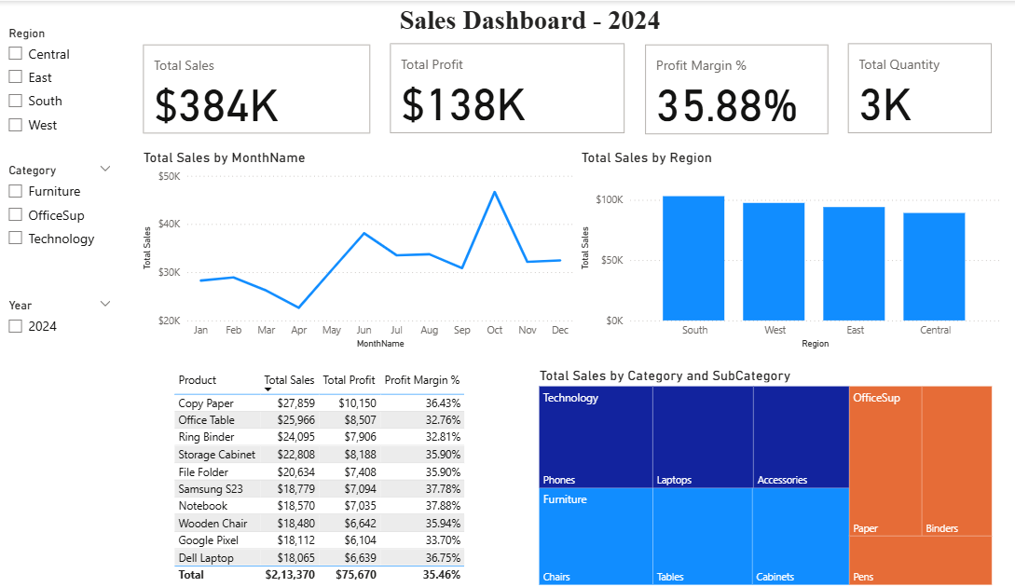
Dashboard Screenshot

Slide 7
Technical Appendix
Data Model: Star schema with Date, Product, and Region dimensions
DAX Examples:
Total Sales = SUM(sales_financial[Sales])
Profit Margin % = DIVIDE([Total Profit], [Total Sales], 0)
Performance Optimization: Removed unused columns, disabled auto date hierarchy

Slide 8
Recommendations
Focus marketing on high-margin regions
Optimize inventory for top products
Address performance decline in Furniture.
Review pricing for low-margin products

